Slide 1
Inflammation and Healing
By
Dr. Alia Mohammed

Slide 2
Inflammation: is a type of response in a living tissue which is exposed to a variety of injuries that involves the vasculature, various inflammatory cells, and potent chemical mediators. The purpose of the inflammatory response is to dilute, isolate, and destroy the injurious.
Types of Inflammation:
Acute: characterized by vascular events and exudation, usually progress over a period of 3 to 10 days, then resolve as the injurious agent is eliminated.
chemical signals: rapid
Vasodilation and increased vascular permeability in capillaries and post-capillary venules

Slide 3
Grossly: The inflamed tissues will be watery (“serous exudate”). If there is a fibrin component (“fibrinous exudates”), you will find web-like strands or sheets of polymerized fibrin adherent to the tissues.
Histologically: These exudates consist of eosinophilic staining in the intercellular space;
fibrin will have the appearance of eosinophilic strands.
Severe injuries: neutrophils will move from the bloodstream. Fish are far less responsive; neutrophilic inflammation will be found, but true pus formation is not seen. Neutrophils are considered to be less phagocytic in fish as opposed to other animals.

Slide 4
Types of inflammatory exudates
Serous exudate
protein-rich, watery fluid; contains protective proteins such as antibodies and complement; eosinophilic material
2. Mucous exudate
from mucous membrane surfaces, due to proliferation of goblet cells more appearance in gills and small intestine
3. Fibrinous exudate
polymerized fibrin forms a major component of the exudate;
strands or sheets adherent to affected tissue; often associated with bacterial infections; eosinophilic strands
4. Neutrophilic exudate
neutrophils are the prominent cellular component; common with bacterial infections in most animal species, but this type of exudate is not as prominent in fish as in other species

Slide 5
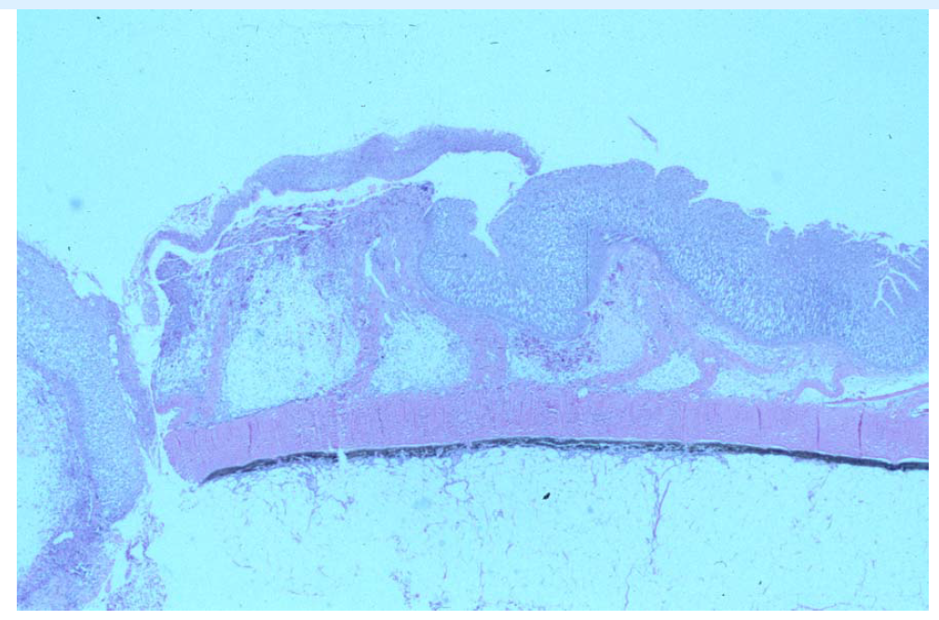
Serous exudate

Slide 6
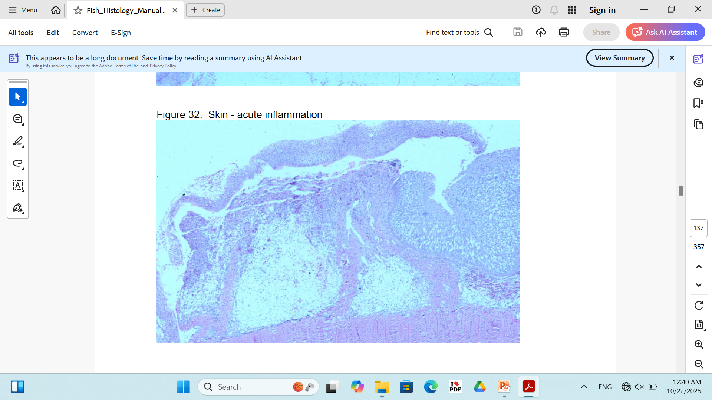
Mucous exudate

Slide 7
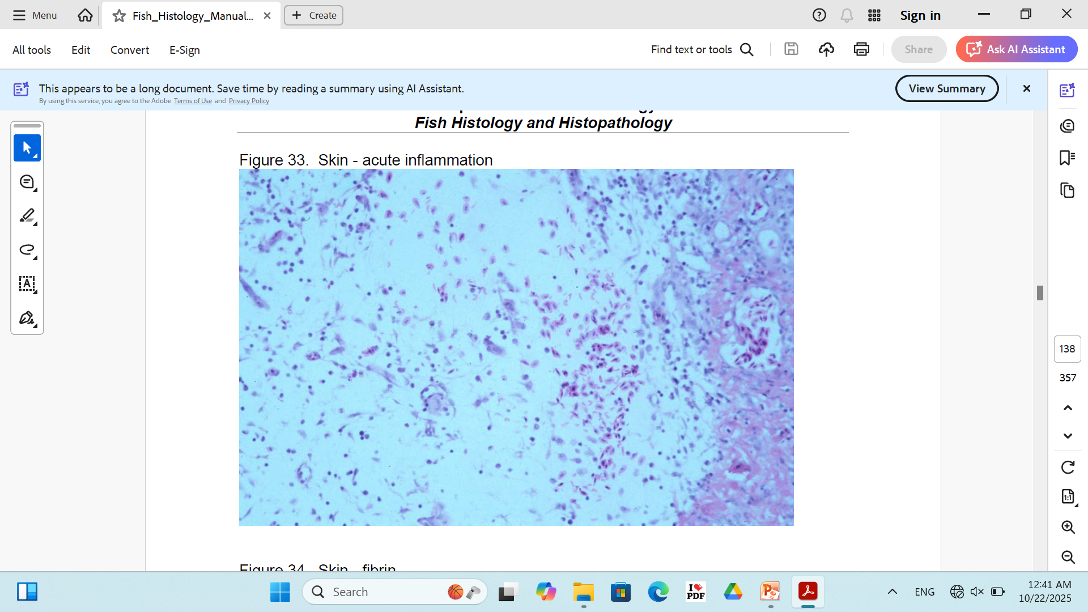
Fibrinous exudate

Slide 8
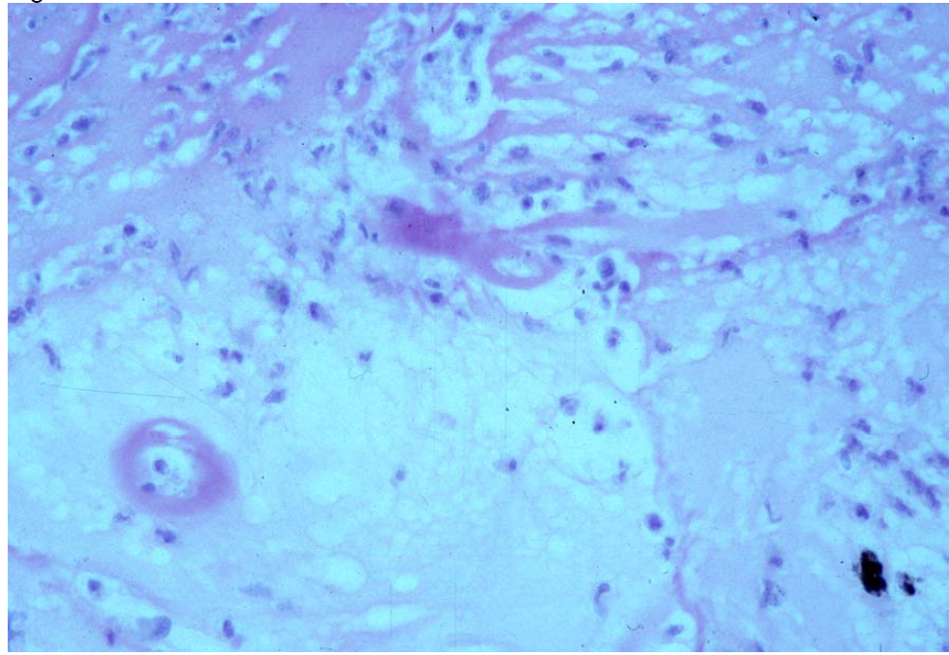
Neutrophilic exudate

Slide 9
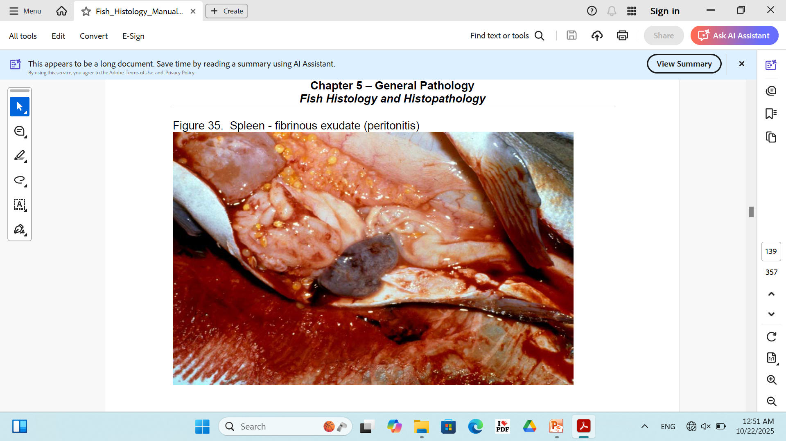

Slide 10
Chronic inflammation: characterized by cellular proliferation, can extend from weeks to months to the lifetime of the host.
Defects in the inflammatory response can lead to chronic illness as well as death. In addition to its protective function, inflammation also sets the stage for healing and repair.

Slide 11
Chronic inflammatory lesions are proliferative and not exudative. There is no flood of fluid and cells from the small blood vessels. Rather, resident or migrating chronic inflammatory cells accumulate and proliferate at the site of injury, and a mass type lesion is formed.
Grossly:Sometimes be difficult to differentiate grossly.
Chronic inflammatory lesions can be composed purely of macrophages, lymphocytes, or plasma cells.

Slide 12
Granulomatous inflammation is the more commonly observed form of chronic inflammation in fish as well as other animals.
It consists of a mixture of macrophages, lymphocytes, plasma cells, fibroblasts, and sometimes neutrophils, all oriented in and around the site of injury.

Slide 13
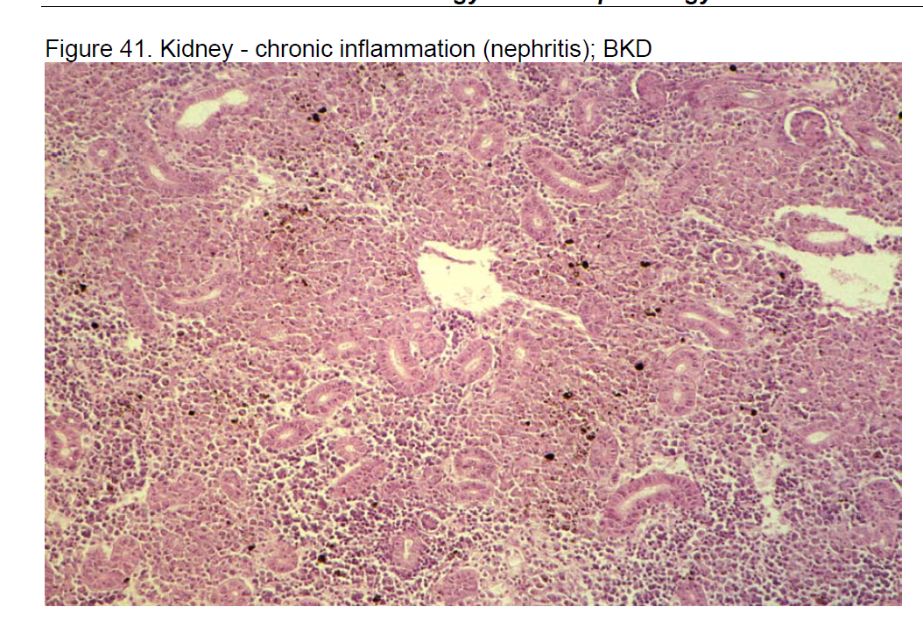

Slide 14
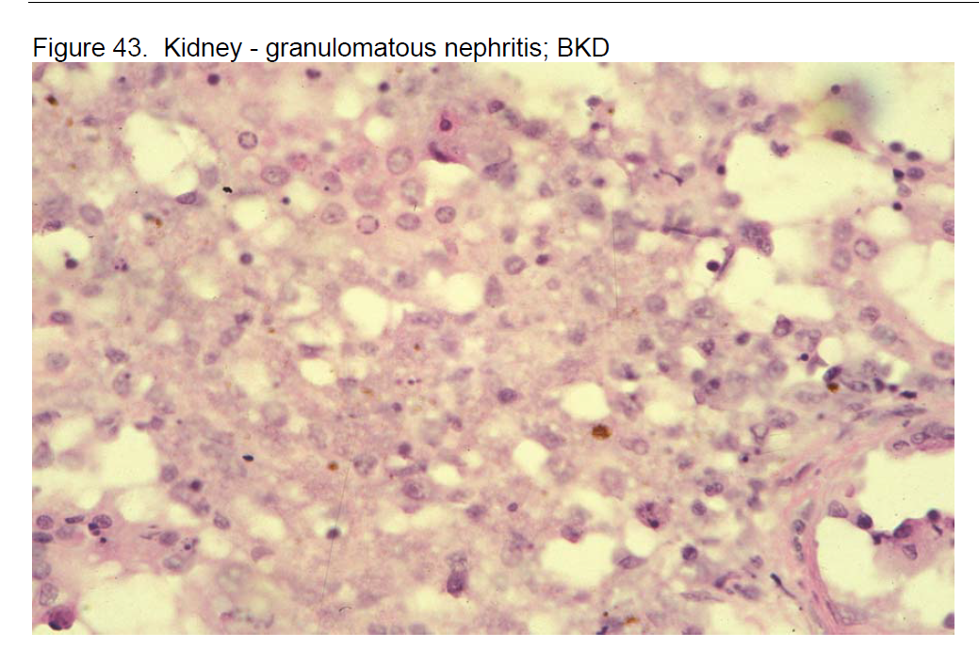

Slide 15
